Slide 1

HOW TO DEAL WITH
CHALLENGING EMPLOYEES
Tuesday, October 21, 2025

Slide 2
Disclaimer
The materials contained in this presentation were created by Laddey, Clark & Ryan, LLP, for informational purposes only and are not intended and should not be construed as a substitute for legal advice.
This seminar is not intended to create an attorney-client relationship between you and Laddey, Clark & Ryan, LLP.
This seminar is not intended to serve as an advertisement or solicitation.
All materials in this seminar are copyrighted © 2025 Laddey, Clark & Ryan, LLP.
The reproduction of any materials contained in this seminar without the permission of Laddey, Clark & Ryan, LLP, is prohibited.

Slide 3

Topics
Employees who are just not a good fit
Performance Issues
Illness/Disability of Employees
Whistleblowers
September 24, 2024

Slide 4

1
EMPLOYEES WHO ARE JUST NOT
A GOOD FIT
Discussion of At-will Employees and Employment Contracts

Slide 5
At-Will Employment
It’s your company, you discipline and terminate…
BUT, be sure to document the non-discriminatory reason

Slide 6
At-Will Employment
Hire slow and fire fast!!
(No required probationary period)

Slide 7
At-Will Employment
In the State of New Jersey, at-will employment is by default:
Unless covered by a contract, civil service or union
At-will employees can be terminated:
  at any time, AND
  for any reason- as long as it’s not a discriminatory reason

Slide 8
At-Will Employment
So, you can just terminate anyone at any time- right?!

Slide 9
Technically, but…
Remember we are in NEW JERSEY.
ALWAYS document reasons for termination of employment.
ALWAYS follow up with a termination letter.
ALWAYS be ready to defend your action.
It was NOT a discriminatory decision.

Slide 10
Contracts May be Useful
Good reasons to use contracts:
Enticing talent
Protecting company interests
Firmly establishing employee wages/benefits and bonuses

Slide 11
But NOT Always Useful or Helpful
NOT good reasons to use contracts:
  Ensuring the employee will stay
  “I got a free form”
  “We’ve always used them”
  “The employee said I had to”

Slide 12
Termination
Good cause termination?
Define it to be helpful to you.
Be very clear.
Use objective standard where can:
Criminal conduct
Violation of policies
Failure to meet expectations
Negative publicity
Monetary goals

Slide 13
Employee Contract Provisions
Compensation Structures
“Hourly” – paid for each hour worked
“Salary” – paid flat amount regardless of amount of time worked – EXEMPT (from over-time)
Commission – paid based on productivity

Slide 14
Employee Contract Provisions
Considerations:
Do you want to change the at-will relationship?
Why a contract now?
Am I comfortable with the termination provisions?

Slide 15
Which leads me to…
Employment Practices Liability Insurance (EPLI):
Covers defense of harassment/discrimination claims made by employees
Deductible/Retainer?
Limits of coverage/amount?

Slide 16

2
PERFORMANCE ISSUES
Use of Performance Reviews and Company Policies

Slide 17
Performance Issues
If there are performance issues:
Do not ignore
Treat all equally
Document!
No good deed goes unpunished

Slide 18
The Purpose of Performance Reviews
Align individual goals with organizational goals
Provide structured feedback and recognition
Identify strengths and areas for growth
Support career development and succession planning

Slide 19
USE Performance Reviews
Document performance issues
Hold supervisors and employees responsible and accountable
Identify weaknesses for all
Support future employment decisions- good and bad

Slide 20
Benefits for Employees
Transparency on the organization’s expectations
Opportunity for recognition
Development planning and skill-building
Enhanced motivation and engagement

Slide 21
Benefits for Employers
Improved performance and productivity
Early identification of talent and leadership potential
Stronger employee retention and satisfaction
Better alignment with organization’s business strategy

Slide 22
Helpful for Employers
Documented history of issues
Proof of shared information
Outline for PIP
Support for employment decisions

Slide 23
BUT…
You actually need to complete performance reviews
  Annually??
AND be honest in reviews
AND have documented issues
For accurate support of employment decisions

Slide 24
Best Practices for Employers
Conduct reviews regularly (not just annually)
Use clear, measurable objectives
Balance constructive feedback with recognition
Encourage a two-way dialogue
Document and follow up on action items

Slide 25
Employment Policies
Use company policies:
To support violations
Back up for employee discipline

Slide 26
Relevant Employment Policies
Harassment and discrimination
Workplace violence
Ethics
Confidentiality
Bullying?
WANT progressive discipline?

Slide 27
Job Descriptions
Help identify core responsibilities
Should be used for evaluations
May support discipline

Slide 28

ILLNESS and DISABILITY
OF EMPLOYEES
Paid Sick Leave, FMLA, NJFLA, Disability and Unpaid Leave of Absence
3

Slide 29
Accrual of Paid Sick Leave
Accrual Minimums:
In each benefit year, employees accrue up to 40 hours of sick time at a rate of one hour for every 30 hours worked;
Employer has the option to frontload the 40 hours at the beginning of each benefit year

Slide 30
Accrual of Paid Sick Leave
Accrual Method – Employees must earn 1 hour of paid sick leave for every 30 hours actually worked, beginning on the 1st day of the benefit year, up to a maximum of 40 hours per year.
Front-Load Method – Employers grant the full 40 hours of sick leave to employees on the 1st day of the benefit year:
More simplified bookkeeping
Immediate use of paid sick leave for employees

Slide 31
Accrual of Paid Sick Leave
Paid sick leave can be used for ANYTHING
Own or a family member’s illness
Domestic violence issue
School activities
Work or school closure due to public health emergency
* Family member = equivalent

Slide 32
Accrual of Paid Sick Leave
Can require wait 120 days of employment before use
Health provider certification can be required ONLY after THREE or more consecutive days of absence
  No more Monday/Friday or holiday issue
  Sick notes for all only after 3 days consecutive absences now

Slide 33
Federal Family and Medical Leave Act (FMLA)
  Covered employers (50 or more employees) must provide covered employees with up to twelve weeks per twelve months of job-protected leave for a qualifying reason.
  Covered employers must notify covered employees of rights under the FMLA.

Slide 34
Types of FMLA Leave
Pregnancy, birth, adoption or foster care.
Care for employee’s own serious health condition.
Care for serious health condition of employee’s spouse, parent, or child.
Qualifying exigency related to a military family member’s call to active duty
Care for the serious injury or illness of a military family member

Slide 35
Family Members
“Spouse” – includes same-sex spouses
“Parent” – adoptive/foster parents; does not include “in-laws”
“Son/Daughter” – If older than 18, the child must:
  Have a disability; and
  Be incapable of self-care due to the disability

Slide 36
FMLA for Military Families
“Qualifying Exigency” Leave – 12 weeks
“Service Member Family” Leave – 26 weeks

Slide 37
New Jersey Family Leave Act (NJFLA)
Covered employers with 30 or more employees receive 12 weeks of leave in 24 months for:
Birth of child
Placement/adoption of child
Serious health condition of employee’s family member (child, spouse, parents, in-laws)
NOT for the employee’s own condition

Slide 38
Benefits Under NJFLA
Not specifically required to continue health insurance.
But must follow employer’s policy on benefits during other temporary leaves.
(NOTE: NJFLI is family leave insurance – payment only)

Slide 39
FMLA and NJFLA
New Jersey employers must comply with both laws
If leave qualifies under both the FMLA and NJFLA, leave can be counted concurrently.

Slide 40
FMLA and NJFLA
When using FMLA Leave
AND
NJFLA Leave
in combination,
Employees can take up to
24 weeks off

Slide 41
Employer Rights and Duties
Notice Requirements:
Public notice
Written notice (at time of hire and upon learning of need for leave)

Slide 42
More Time Off OR PTO?
Beware old maternity/paternity policies
PTO banks can be effective

Slide 43
Disability Discrimination and Accommodations
Governed by New Jersey’s Law Against Discrimination (NJLAD)
Provides broader protections than the federal Americans with Disabilities Act (ADA)
Applies to nearly all employers, regardless of size

Slide 44
Actions of Disability Discrimination
Refusing to hire, promote or grant tenure to a person with a disability
Terminating, laying off or demoting employees
Retaliating against an employee due to a request for accommodation
Subjecting employees to harassment or creating a hostile work environment

Slide 45
Disability under NJLAD
The definition of disability is broad and protects employees from discrimination based on actual, perceived or a history of disability, including:
Physical, mental, psychological and developmental conditions
Temporary conditions, such as COVID-19
Conditions in remission, such as cancer and multiple sclerosis

Slide 46
Employer obligations for Reasonable Accommodations
New Jersey employers must provide reasonable accommodations to employees with disabilities, as long as the employee can perform “essential functions” of their job with the accommodations that are put in place for them AND it does NOT create an undue hardship.

Slide 47
The Interactive Process
Once an employer is aware of need for an accommodation, MUST engage in good-faith interactive dialogue to find a workable solution. Use of the phrase "reasonable accommodation" NOT required to trigger this requirement.
Employer and employee should work together to:
Discuss the employee’s limitations and job tasks
Explore different accommodation option
Document all discussions and decisions

Slide 48
Examples of Reasonable Accommodations
Modified work schedules or breaks: adjustments to work hours, remote work or additional breaks for medical treatment.
Leave of Absence: providing medical leave beyond standard entitlements like FMLA
Workplace Modifications: adding ramps, providing ergonomic equipment or adjusting desks

Slide 49
Examples of Reasonable Accommodations
Job Restructuring: reassigning non-essential duties to other employees.
Assistive Technology: acquiring or modifying equipment or providing specialized software.
Reassignment to a Vacant Position: If an employee can no longer perform the essential functions of their current job, reassigning them to an equivalent vacant position can be a reasonable accommodation.

Slide 50
Undue Hardship Exception
Employer can deny an accommodation only if it would cause an "undue hardship" – a significant difficulty or expense for the business.
Determination is made on a case-by-case basis, taking into account factors such as the employer's size, resources, and overall operations.

Slide 51
Unpaid Leave of Absence
A leave of absence (“LOA”) is an optional arrangement approved in advance for a period of absence without pay for the purpose of protecting an employee’s service.
A LOA will not constitute a break in employees’ records of continuous employment, provided the employee is reinstated at or prior to the expiration date of the leave.

Slide 52
Unpaid Leave of Absence
Factors to consider when evaluating a LOA:
Reason for leave
Employee’s length of service
Employee’s job performance (require NO issues or certain score)
Effect on your firm’s operational requirements
Any other factor you find relevant

Slide 53
Unpaid Leave of Absence
Have a policy in place and follow it
Can require use of all paid leave first
LOA requests must be submitted in writing with supporting documents (if applicable)
All employees must be subject to the same leave benefits in accordance with established written policies

Slide 54
Unpaid Leave of Absence
At the conclusion of an approved leave, the employee should be reinstated to their former position, or to a position of like status, seniority and pay, unless circumstances have changed to make it unreasonable, if not impossible, to do so.
An employee on leave who fails to return to work at the end of the approved leave duration can be terminated effective his/her last day of work or paid leave, whichever is later.

Slide 55

4
WHISTLEBLOWERS
CEPA and how to best protect yourself, including providing required notice

Slide 56
Conscientious Employee Protection Act (CEPA)
CEPA prohibits all public and private employers with TEN or more employees from retaliating against employees who disclose, object to, or refuse to participate in certain actions that the employees reasonably believe are either illegal or in violation of public policy.
**Often referred to as New Jersey’s “Whistleblower” law.

Slide 57
CEPA
Employers must not retaliate against employees who:
  Disclose, or threaten to disclose an activity, policy or practice of the employer, or another employer, with whom there is a business relationship, that the employee reasonably believes is unlawful; or
  Provide information to/testify before, any public body conducting an investigation, hearing, or inquiry into violation of law by the employer, or another employer, with whom there is a business relationship; or
  Object to/refuse to participate in any activity, policy, or practice the employee reasonably believes violates the law, is fraudulent/criminal, or violates public policy

Slide 58
CEPA Required Notice
Annual distribution
Identify a contact person on the notice
Obtain signed acknowledgements- electronic is OK
Required publication of notice, “conspicuously displayed”
May be required in Spanish too

Slide 59
Prevent CEPA Claims
Document all performance issues
Have clear CEPA, harassment and discrimination policies
Have effective complaint policy
Train all employees and supervisors
Monitor the workforce

Slide 60
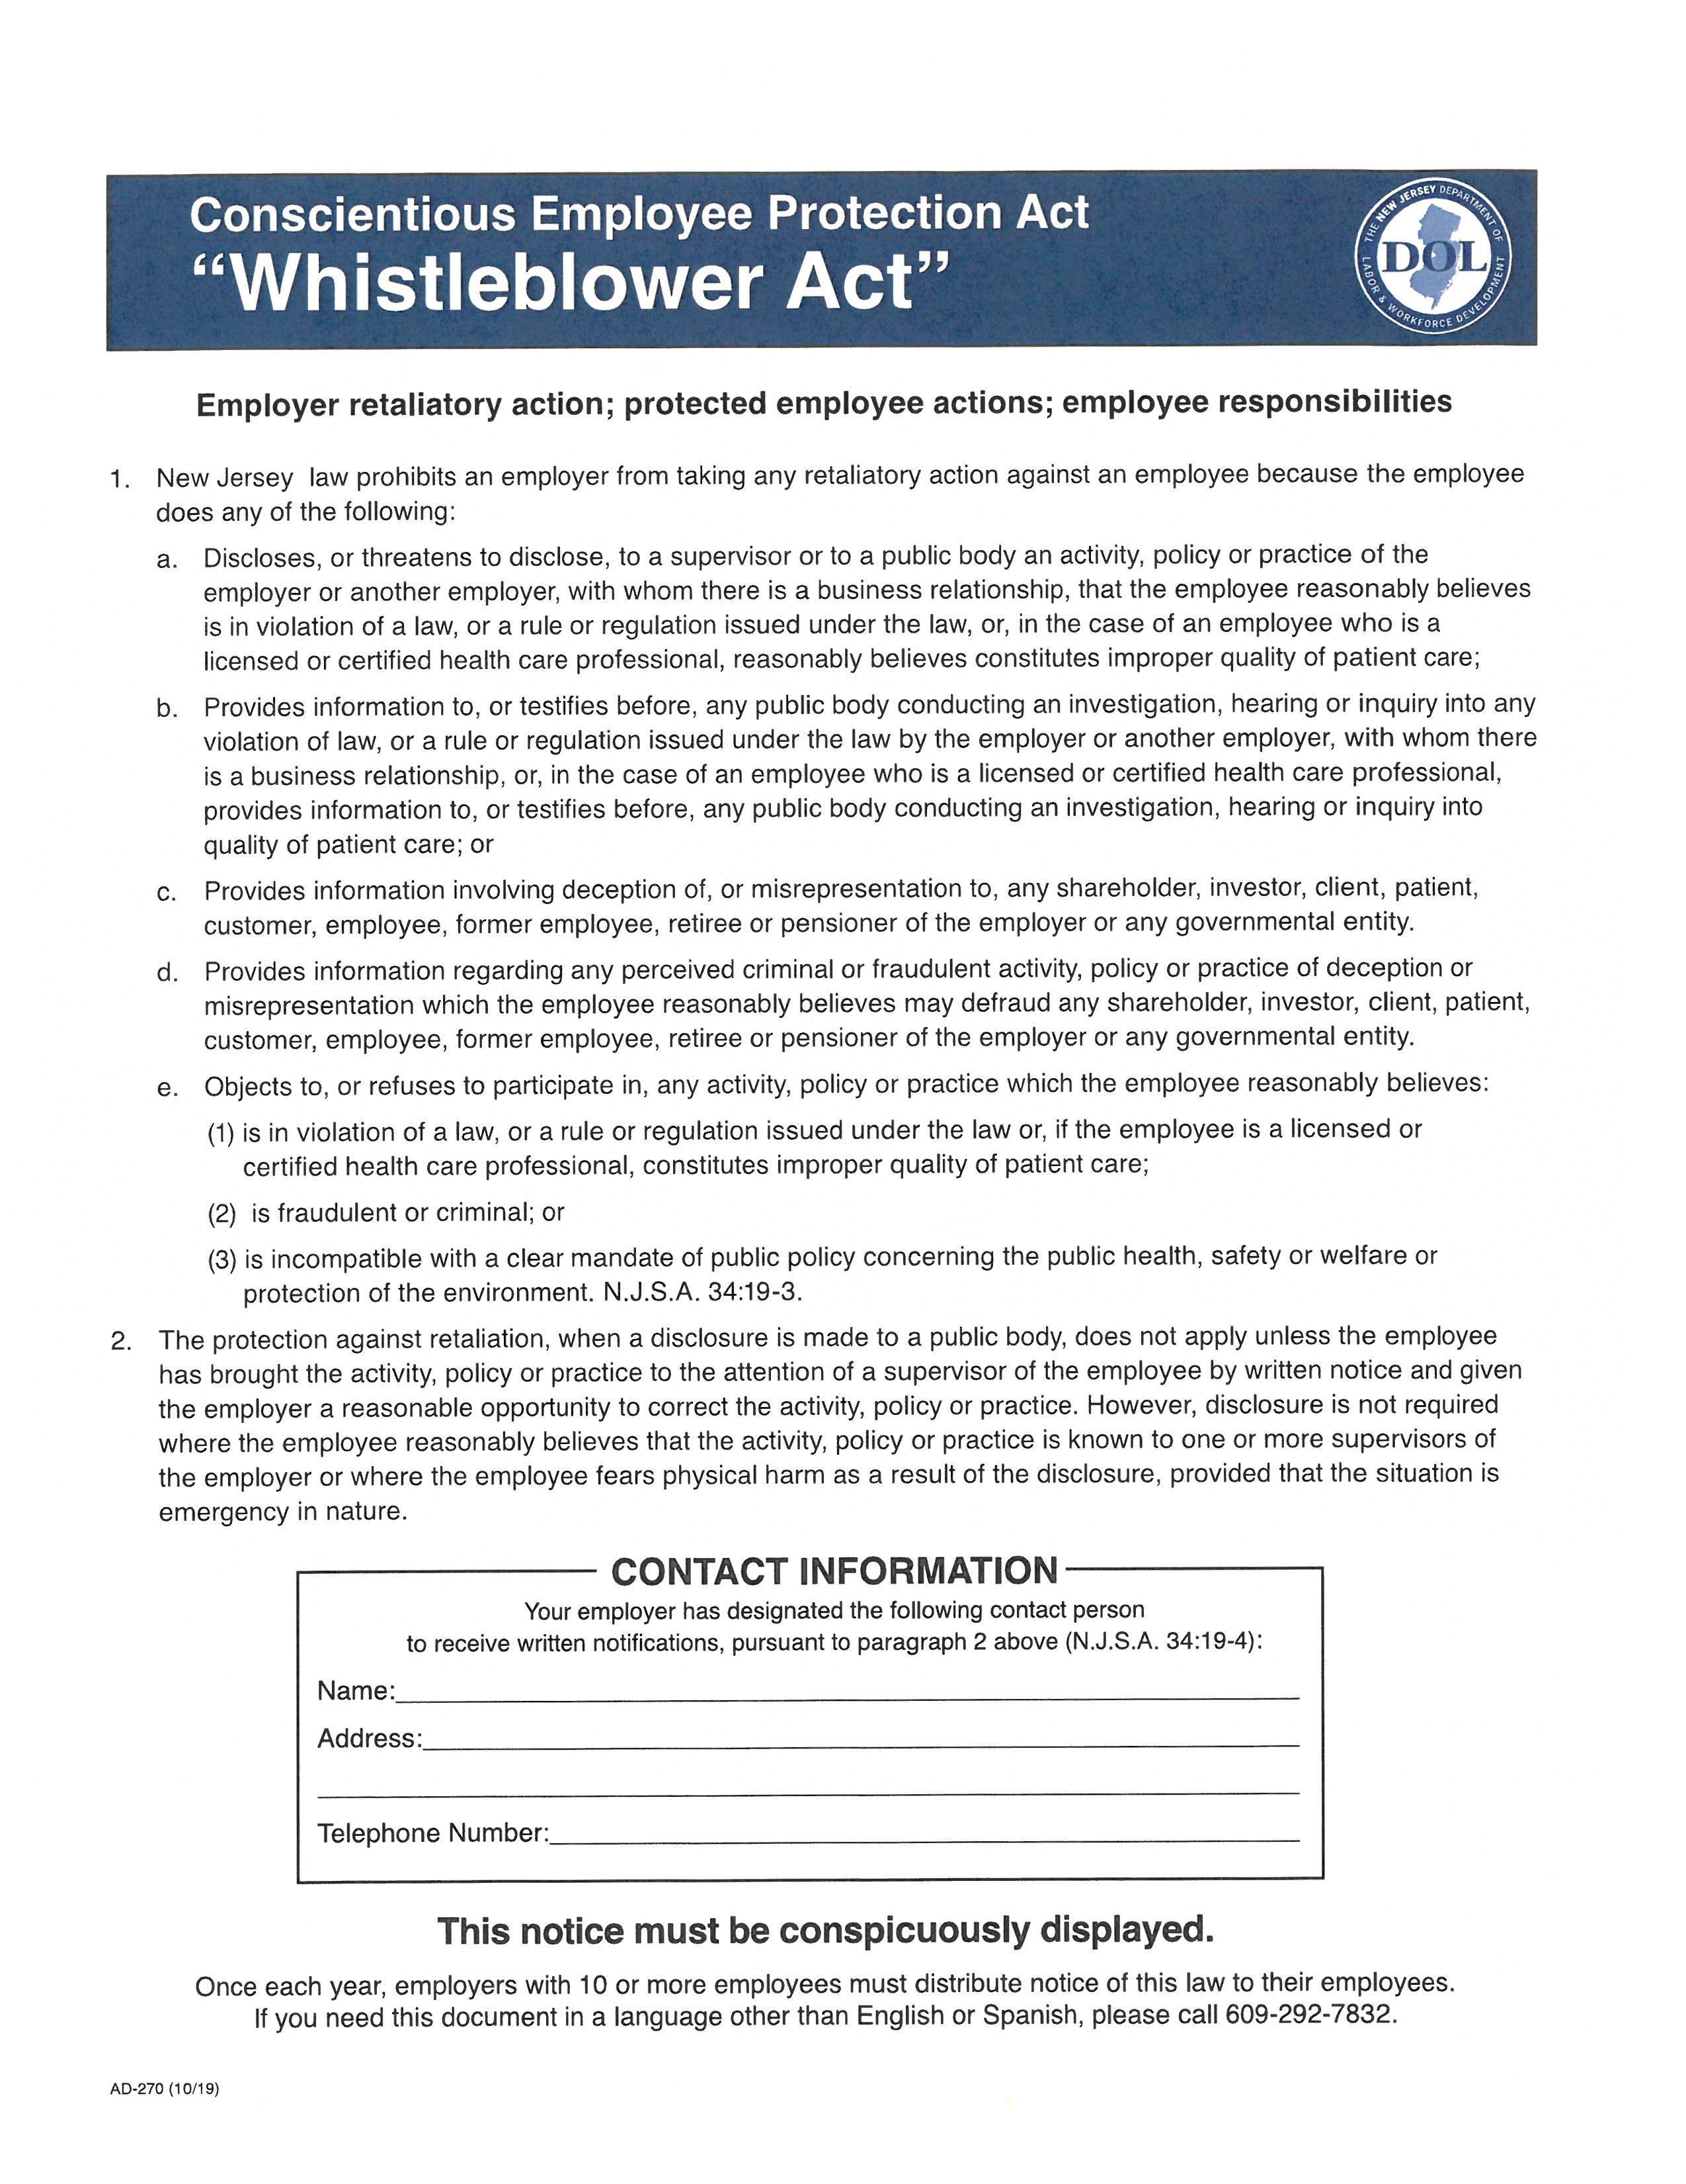
CEPA Notice

Slide 61
Prevent CEPA Claims
Build a strong compliance culture by reviewing company policies and procedures with a “whistleblower”/non-retaliation policy and encourage employees to report concerns internally
Create internal safe reporting channels to assure employees reports will be investigated promptly with no tolerance for retaliation
Educate management on proper discipline
Document performance reviews and decisions based on those records
Handle complaints carefully
Foster trust and transparency with open communication

Slide 62





Connect with Laddey, Clark
& Ryan LLP
LIKE US
CONNECT WITH US
FOLLOW US

